Slide 1
Intelligent robots in factories
By: Dawit Abay & Alif Dastegir

Slide 2
How robots are used in industry?
welding, assembly, and picking and packing robots are the most common types of industrial robots, some industries use robots to perform other tasks. ... Aerospace, automotive, electronics, food and textile industries use water-jet robots to cut, drill and clean a variety of materials.

Slide 3
How are robots being used in manufacturing?
Robots protect workers from repetitive, mundane and dangerous tasks, while also creating more desirable jobs, like engineering, programming, management and equipment maintenance.

Slide 4
Where is an industrial robot used?
Robot are used in manufacturing in the
food
pharmaceutical
electronic industries
Other

Slide 5

What is the most common manufacturing robot made of?
The most common manufacturing robot is the robotic arm

Slide 6
What is a robot made of?
Robots can be made from a variety of materials including metals and plastics. Most robots are composed of 3 main parts

Slide 7




















A* algorithm
A* is a graph traversal and path search algorithm, which is often used in computer science due to its completeness, optimality, and optimal efficiency.

Slide 8
different factory robots
Cartesian
SCARA
Medical robot
Industrial robot
Polar
Military robot

Slide 9
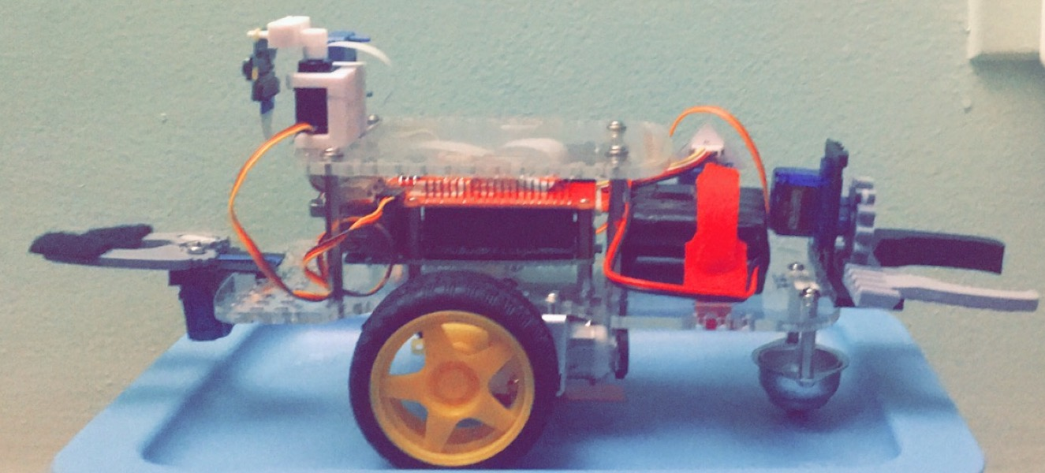
This is my small idea r0b0t

Slide 10
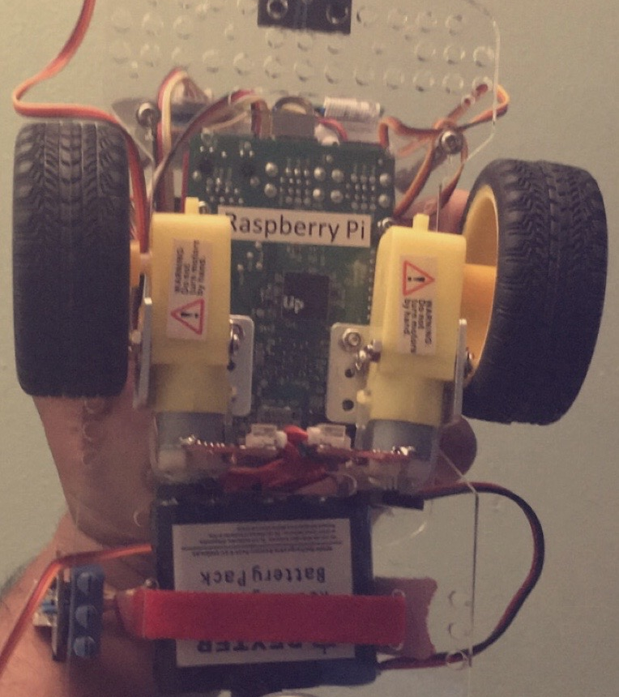
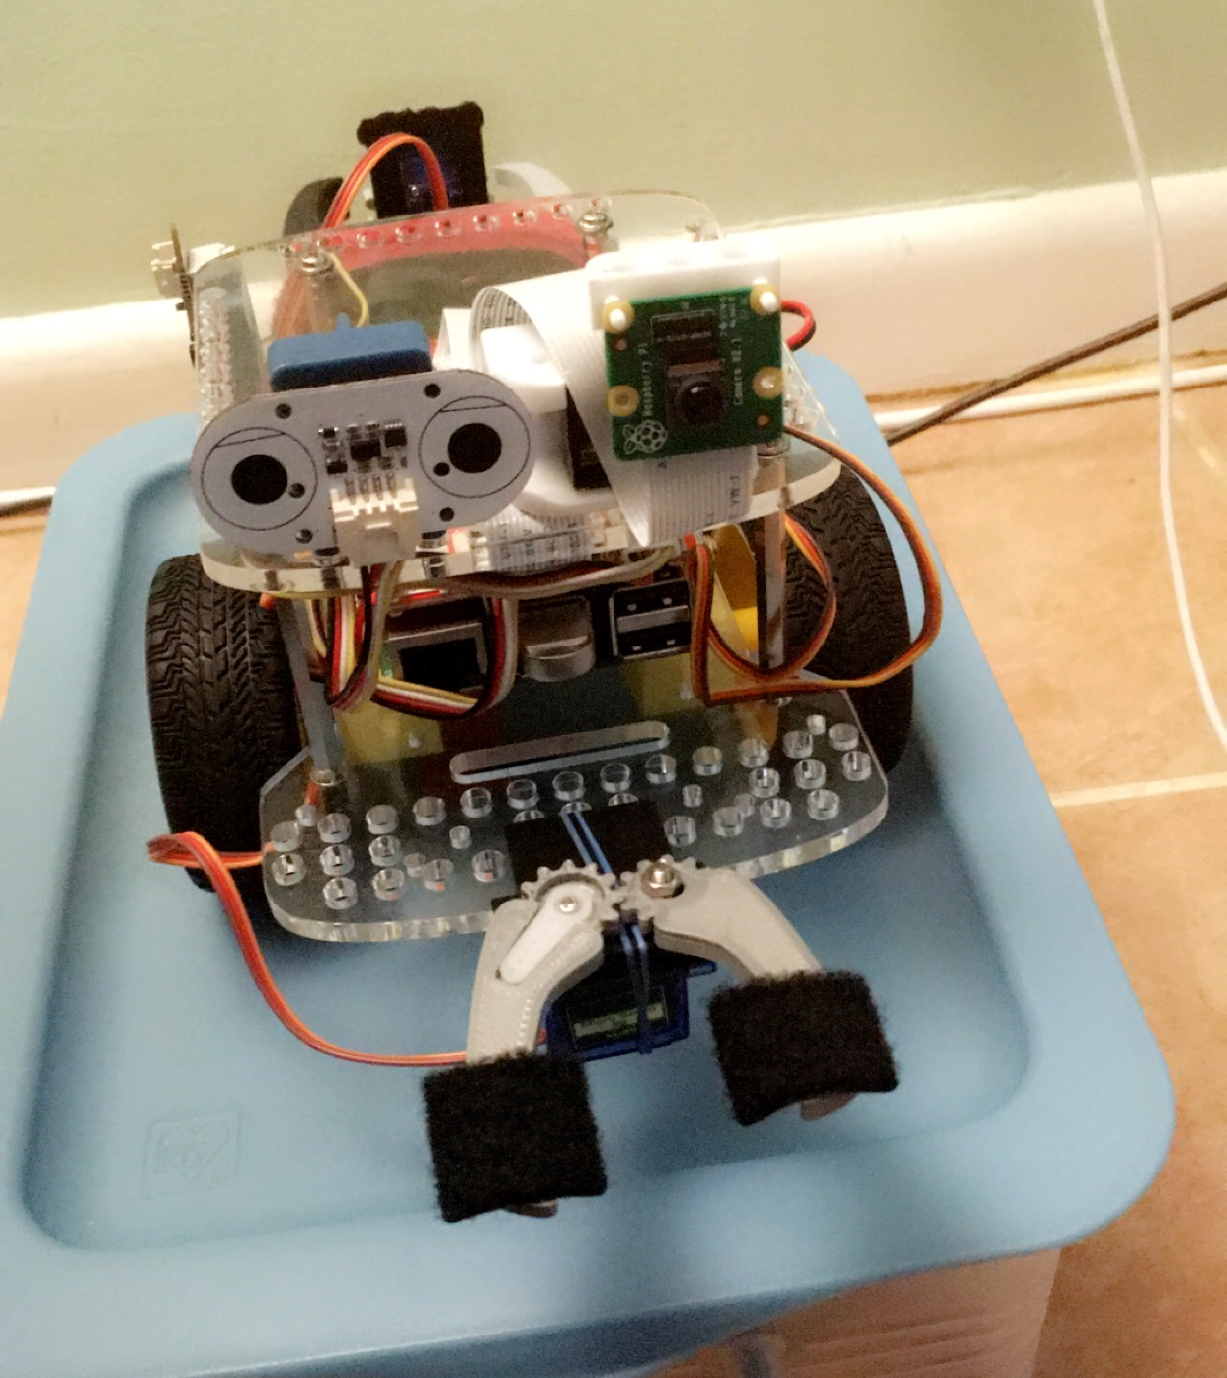
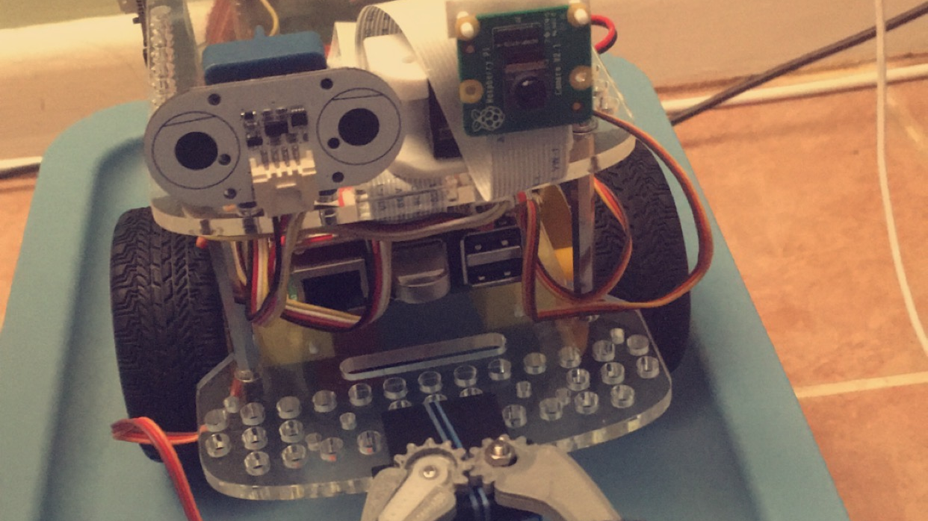
Robot Layout
It has 3 Servo motor
It has Distance Sensor
It has microSD Card
It has Raspberry Pi 3
It has camera
It wheels and motor
3D model of the arms
It has Electronic Board
It has IMU Sensor

Slide 11
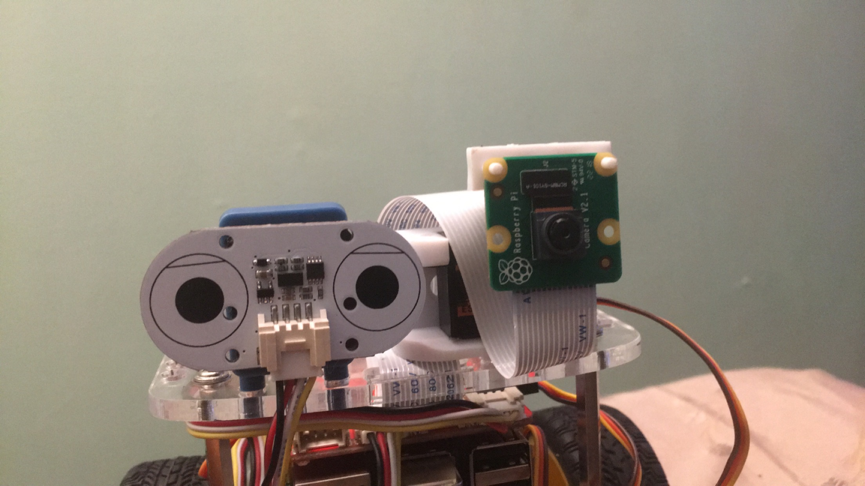
Raspberry Pi Camera & Distance Sensor
The distance sensor uses a small laser to determine the distance to an object. The sensor uses the Time of Flight method for a very fast and accurate distance reading.
It can take pictures and HD video.
This five mega pixel fixed-focus camera supports
1080p30
720p60
VGA90 video modes

Slide 12
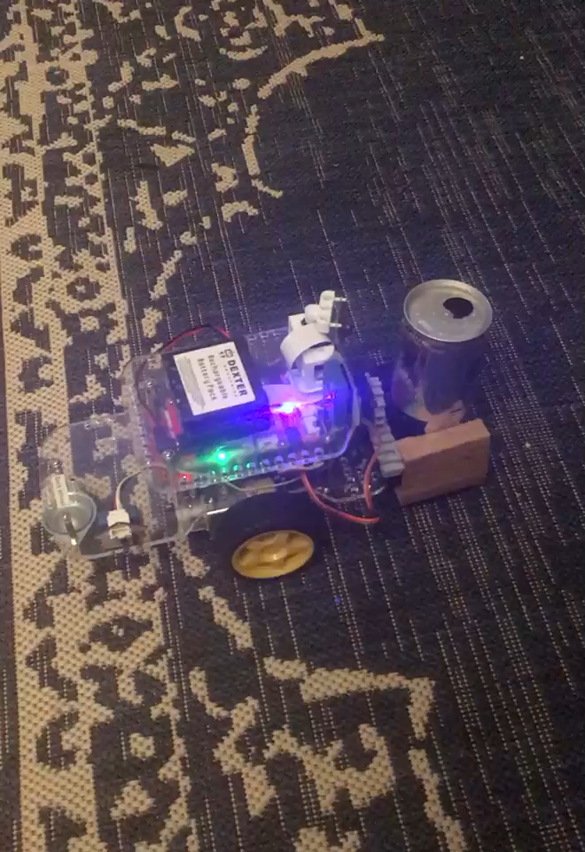
Demo

